Slide 1
Cocaine

Slide 2
Cocaine Research Report
Cocaine is a powerfully addictive stimulant drug. People have used the drug in South America for thousands of years. In the early 1900s, purified cocaine was the main active ingredient in many tonics and elixirs developed to treat a wide variety of illnesses.

Slide 3
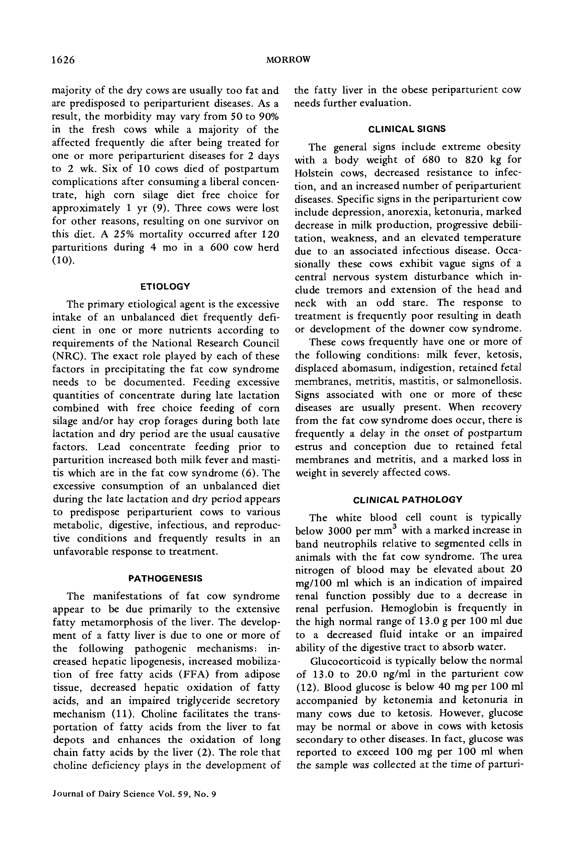

Slide 4
Cocaine Use in the United States
In 2020, approximately 19,447 people died from an overdose involving cocaine.

Slide 5
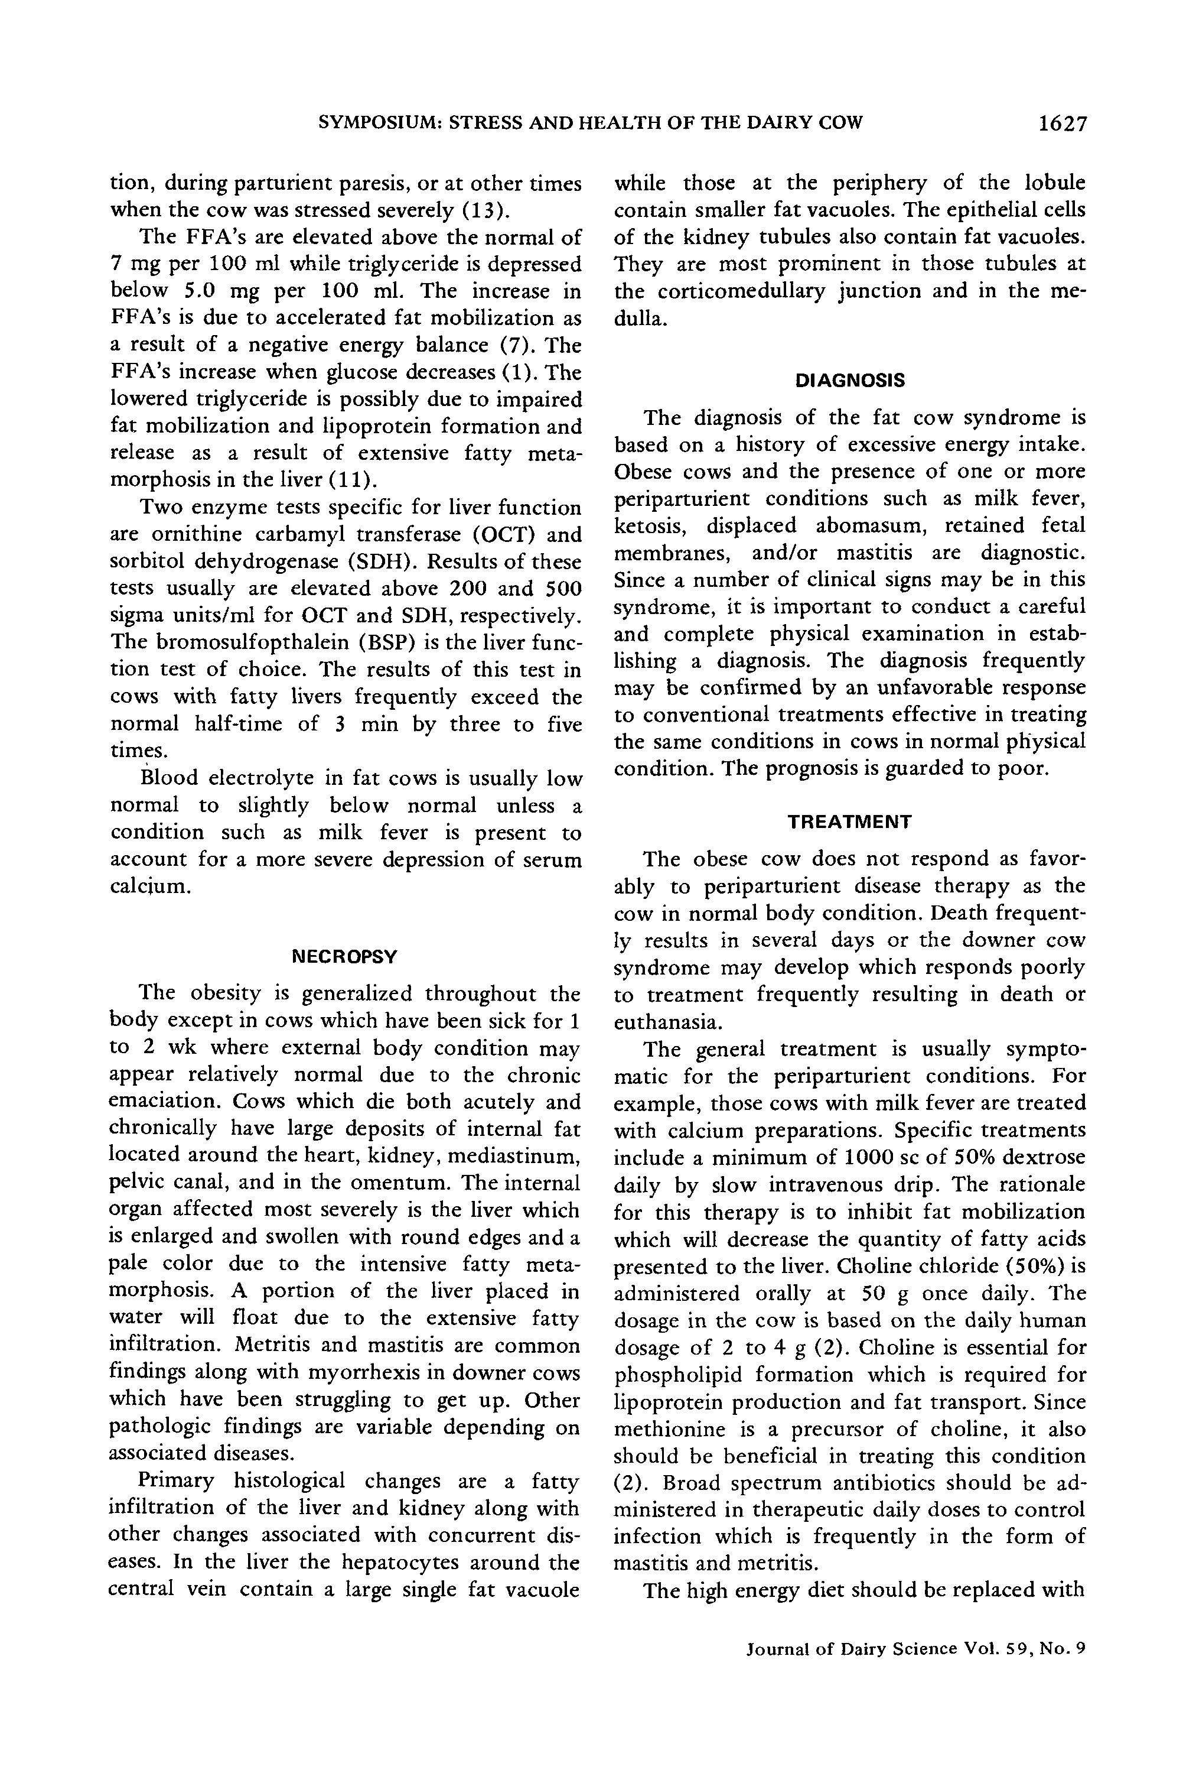

Slide 6
Administration
Cocaine is a powerful, highly addictive stimulant drug. Cocaine use can lead to addiction, which can have severe physical, psychological, and social consequences.

Slide 7
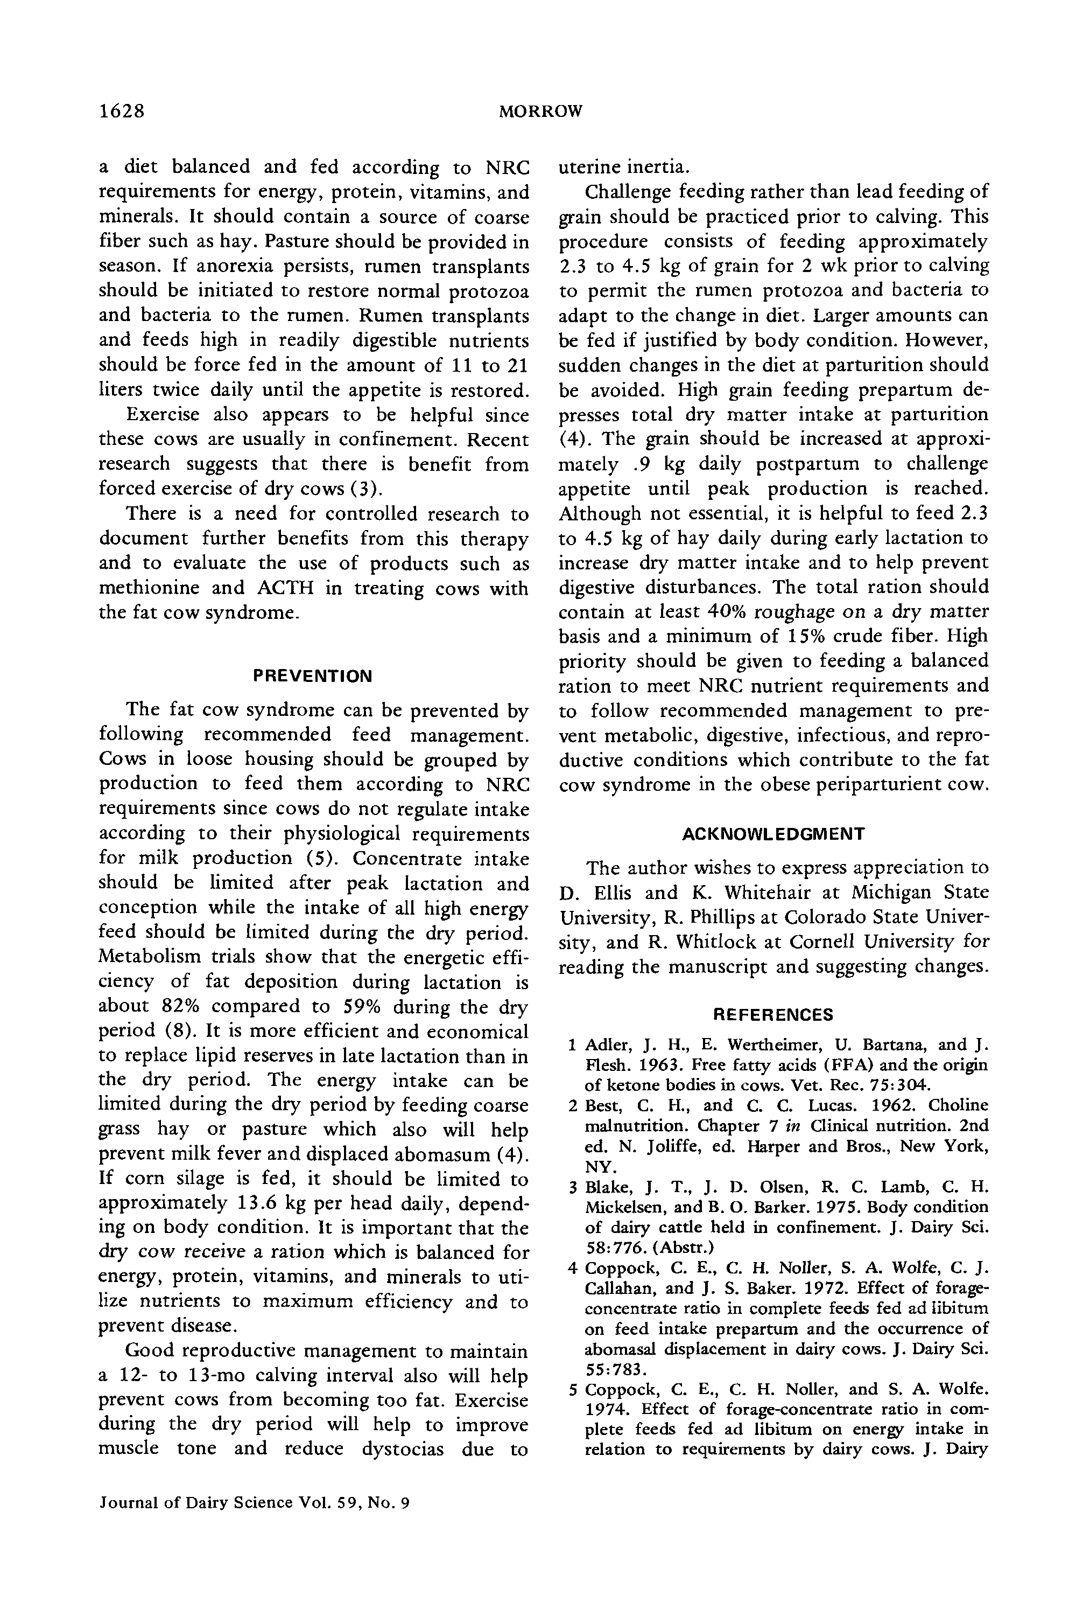

Slide 8
Dopamine Reward
Dopamine is a neurotransmitter that plays a role in the brain's reward system. It is released by neurons in the synapse, where it binds to specialized proteins called dopamine receptors on the neighboring neuron. This process carries a signal from neuron to neuron.

Slide 9
Cocaine Changes the Brain
Cocaine is a highly addictive drug that affects the brain's reward network. Cocaine use can lead to tolerance, which means users need to take more of the drug to achieve the desired effect.

Slide 10


Slide 11
Cocaine addiction
Cocaine addiction is a complex disease that involves changes in the brain’s reward system. Research suggests that the glutamate system plays a key role in this process. This article reviews the current understanding of how cocaine addiction affects the brain.

Slide 12
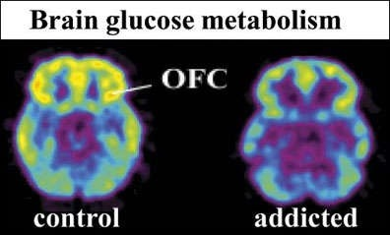

Slide 13
Cocaine Effects.
Cocaine use can have many shortterm effects, including euphoria, energy, talkativeness, and alertness. Cocaine can also cause anxiety, panic, and paranoia. Longterm effects of cocaine use include addiction, respiratory depression, and stroke.

Slide 14
Effects of Cocaine
Cocaine is a powerful, addictive drug that can have serious, longterm effects on the brain and body.

Slide 15
Cocaine Damages
Cocaine use can lead to a variety of health problems. Cocaine use can lead to addiction. Cocaine use can lead to death.

Slide 16
Cocaine Use and HIV
Cocaine use is associated with increased risk for HIV and HCV infection. Cocaine use can accelerate HIV infection. Cocaine use can accelerate the development of NeuroAIDS.

Slide 17
Cocaine Use During Pregnancy
Cocaine use during pregnancy is associated with maternal migraines and seizures, premature membrane rupture, and separation of the placental lining from the uterus prior to delivery.

Slide 18
Cocaine Exposure in Utero
Cocaine is a highly addictive drug that can lead to dependence. Cocaine addiction can be treated with behavioral therapy and medications.

Slide 19
Cocaine
Cocaine addiction is a complex brain disorder characterized by a strong desire to use cocaine and the inability to stop using it. Researchers are developing medications and behavioral interventions to treat cocaine addiction. Scientists are also investigating medical interventions to address the acute emergencies that result from cocaine overdose.

Slide 20
Effective treatments
Cocaine addiction is a complex health problem that can have a devastating impact on individuals, families, and communities. Fortunately, a range of behavioral and pharmacological treatments are available to help people with this disorder.

Slide 21
Cocaine addiction treatment
Cocaine use disorder is a chronic condition that can be effectively treated with behavioral therapy, medication, and counseling. Research is ongoing to find new and better treatments.

Slide 22
Cocaine addiction
Cocaine addiction is a complex disease that involves many factors, including genetics, environment, and brain chemistry. Researchers are using cuttingedge technologies such as genetics and brain imaging to better understand the disease.

Slide 23
Cocaine Dependence
Brain imaging technologies are revealing how the brain changes with longterm cocaine use and how it recovers with abstinence. These technologies are also helping to create a map of the brain’s network of interconnected circuits.

Slide 24
Cocaine
Cocaine is a powerful, addictive drug that acts directly on the brain. Cocaine use can lead to severe physical, psychological, and social consequences.

Slide 25
Cocaine
Cocaine is a powerful, addictive stimulant that can be smoked, snorted, or injected. Cocaine use can lead to addiction and can have serious health consequences.

Slide 26
Key phrase: "NIDA websites and webpages"
This fact sheet provides information about the history of cocaine. It will be updated as needed.

Slide 27
Cocaine
Cocaine is a powerful, addictive drug that can have a wide range of effects on the brain and body. This article reviews the effects of cocaine on the brain and body, as well as the potential for addiction.

Slide 28
Cocaine and HIV
Cocaine is a powerful central nervous system stimulant that can cause a variety of medical problems. Cocaine use during pregnancy can lead to a variety of health problems for both the mother and the fetus.

Slide 29
Cocaine exposure
Cocaine use during pregnancy is a major concern for health care providers. This article reviews the effects of cocaine exposure on the fetus and newborn.

Slide 30
Cocaine
The authors review the state of the art in the development of novel medications and vaccines for the treatment of cocaine addiction.

Slide 31
Cocaine dependence treatment
Cocaine addiction is a chronic condition characterized by compulsive use of the drug despite negative consequences. This article reviews the current evidence for the use of behavioral therapy, contingency management, and other treatment strategies for cocaine addiction.

Slide 32
Key phrase: "Genetic and Epigenetic Factors in Addiction"
This paper reviews the neurobiological and genetic mechanisms underlying addiction. It also discusses the role of epigenetic mechanisms in addiction.

